Slide 1
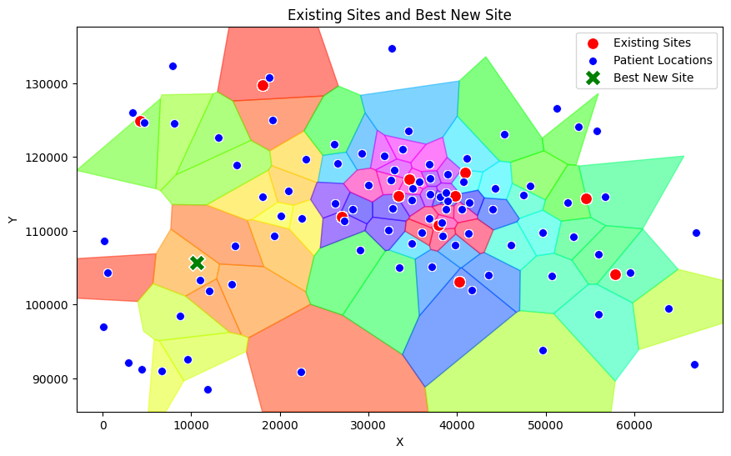
Business Report
Optimizing Accident & Emergency (A&E) Department Locations
Glauco Rampone, Camilla Andreozzi
University of Glasgow, Mathematics & Statistics
Introduction
This report presents the outcomes of the Undergraduate Operational Research Challenge for Public Health Scotland.
The project’s goal was to optimize the locations for one or more new A&E departments to address patient wait times effectively.
Two distinct solutions were identified, each focusing on a unique objective:
Centrally Located A&E Department
Strategically Located A&E Department
Coordinates:
Coordinates:
Objective: Achieve a large total reduction in patient wait times and driving times in a specific high demand area.
Key Insights: Location was selected using Voronoi mapping and analysis of patient distribution. This solution addresses the overarching need for equitable healthcare access. Benefits are concentrated in specific regions.
Key Metrics:
Average Wait Time Reduction: 25,000 minutes
Average Distance to Nearest A&E: 8 km
Percentage of patients benefiting from the solution: 100%.
Benefits: Enhances the overall equity of patient care. Provides targeted relief in high-demand areas.
Challenges: The model assumes that patients always choose the nearest department. As a result, patients in the city center may not experience substantial benefits under this assumption.
Objective: Reduce wait times and driving times for all patients uniformly across the region.
Key Insights: Location was selected using Linear, Poisson and Gamma models. It is designed to ease the pressure on all other departments.
Key Metrics:
Average Wait Time Reduction: 28 minutes
Average Distance to Nearest A&E: 10 km
Percentage of patients benefiting from the solution: 100%.
Benefits: Maximizes the system’s overall efficiency. Addresses system-wide inefficiencies.
Challenges: Works under the assumption that the main demand will be always concentrated in the center and habits will not change with a new department.
Combined Solutions
Key Metrics:
Average Wait Time Reduction: 15minutes
Percentage of Patients with Reduced Wait Time: 95%
Average Distance to Nearest A&E: 10 km

